Slide 1
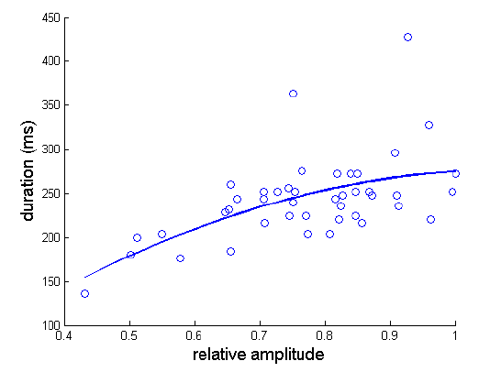
Chapter 3
Overdetermined linear systems

Slide 2
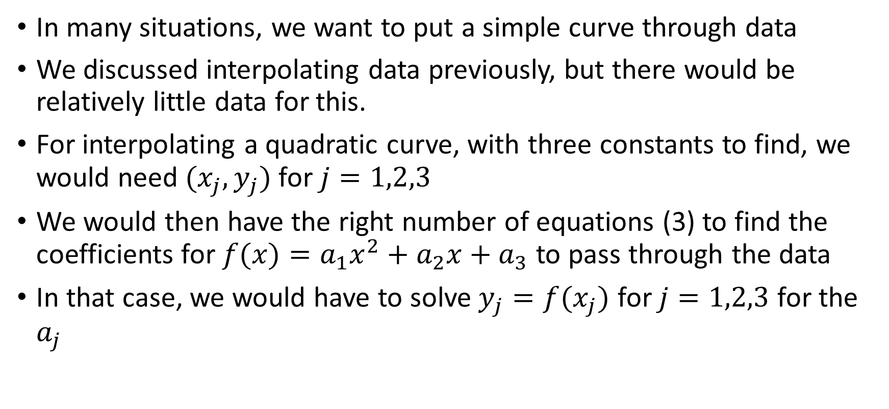
Overdetermined linear systems
In many situations, we want to put a simple curve through data
We discussed interpolating data previously, but there would be relatively little data for this.
For interpolating a quadratic curve, with three constants to find, we would need $(x_{j},y_{j})$for $j=1,2,3$
We would then have the right number of equations (3) to find the coefficients for $f(x)=a_{1}x^{2}+a_{2}x+a_{3}$ to pass through the data
In that case, we would have to solve $y_{j}=f(x_{j})$ for $j=1,2,3$ for the $a_{j}$

Slide 3
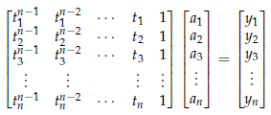

Overdetermined linear systems
The system is of the following form, with $n=m=3$:
But, there are many cases where there is too much data to interpolate because the oscillation of polynomials would be a poor model

Slide 4

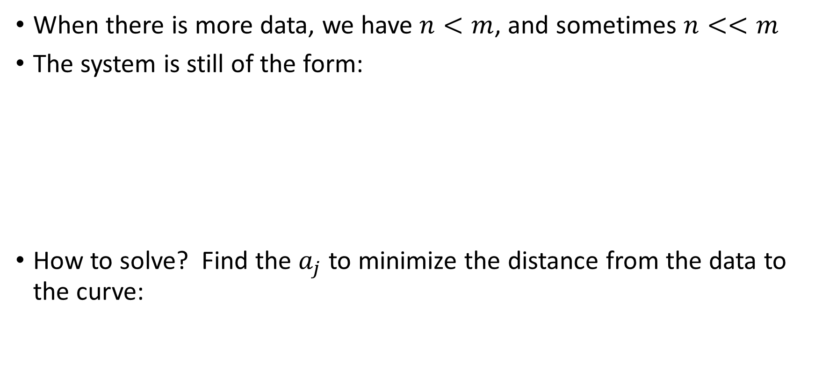
Overdetermined linear systems
When there is more data, we have $n<m$, and sometimes $n<<m$
The system is still of the form:
How to solve? Find the $a_{j}$ to minimize the distance from the data to the curve:

Slide 5
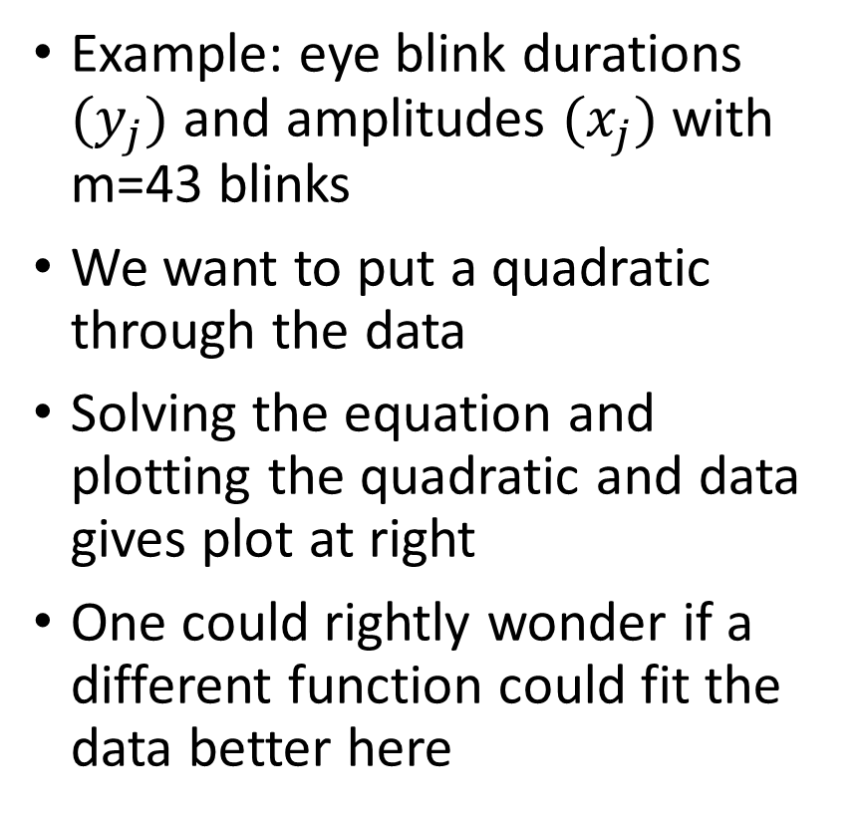
Overdetermined linear systems
Example: eye blink durations $(y_{j})$and amplitudes $(x_{j})$with m=43 blinks
We want to put a quadratic through the data
Solving the equation and plotting the quadratic and data gives plot at right
One could rightly wonder if a different function could fit the data better here

Slide 6
Overdetermined linear systems
How to solve these problems?
For this minimization problem, we could compute the partial derivative with respect to each a_j and set the derivative equal to zero.
Solving those equations would produce the coefficients and thus the function we seek.
Linear least squares are often approached this way.
We want to focus on a more linear algebra oriented approach

Slide 7

Overdetermined systems
More generally, we can seek linear combos of functions for fitting
For this minimization problem, we consider the residual
From linear algebra, and we can write the following…

Slide 8
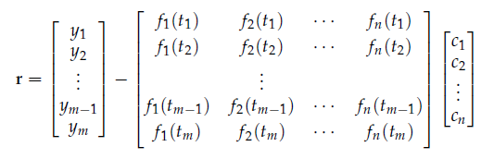



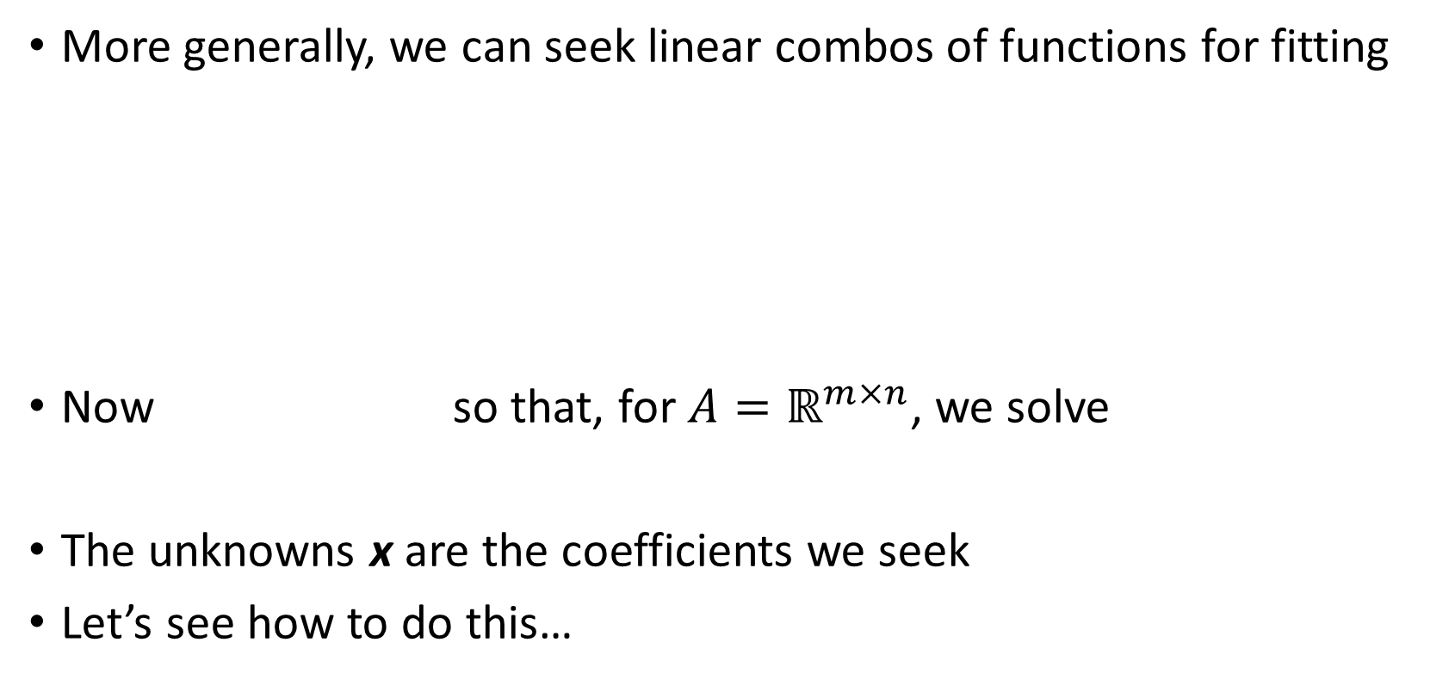
Overdetermined systems
More generally, we can seek linear combos of functions for fitting
Now so that, for $A=ℝ^{m×n}$, we solve
The unknowns x are the coefficients we seek
Let’s see how to do this…

Slide 9
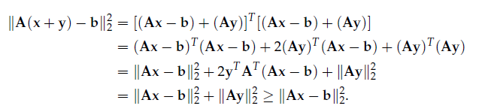
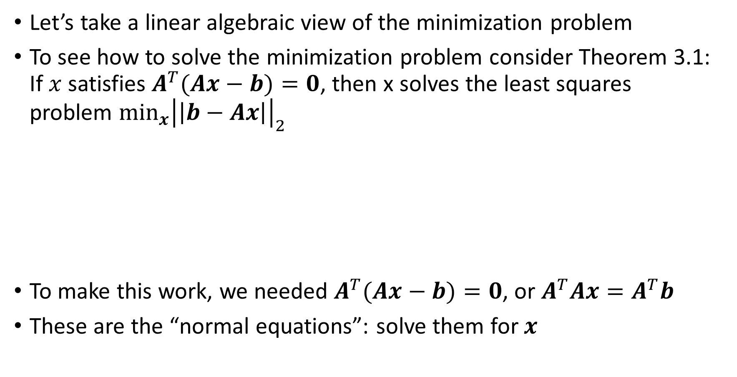
Overdetermined systems: The Normal Equations
Let’s take a linear algebraic view of the minimization problem
To see how to solve the minimization problem consider Theorem 3.1: If $x$ satisfies $A^{T}(Ax−b)=0$, then x solves the least squares problem $\min_{x}{{\left|\left|b−Ax\right|\right|}_{2}}$
To make this work, we needed $A^{T}(Ax−b)=0$, or $A^{T}Ax=A^{T}b$
These are the “normal equations”: solve them for $x$

Slide 10
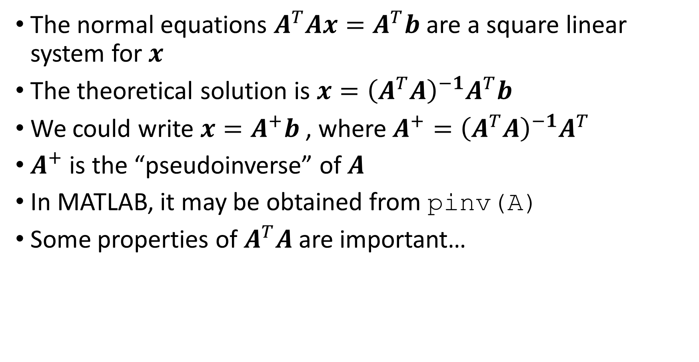
The Normal Equations
The normal equations $A^{T}Ax=A^{T}b$ are a square linear system for $x$
The theoretical solution is $x={{\left(A^{T}A\right)}^{−1}A}^{T}b$
We could write $x=A^{+}b$ , where $A^{+}={{\left(A^{T}A\right)}^{−1}A}^{T}$
$A^{+}$ is the “pseudoinverse” of $A$
In MATLAB, it may be obtained from pinv(A)
Some properties of $A^{T}A$ are important…

Slide 11
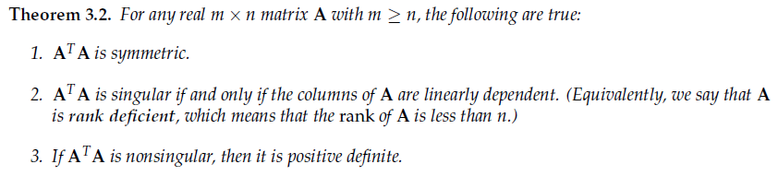

The Normal Equations
Some properties of $A^{T}A$ are important…
For 2, if $A^{T}A$ is singular, then $A^{T}Az=0$ for nonzero $z$; we need to show that this happens only if $A$ is singular. If we premultiply by $z^{T}$, then $0={z^{T}A}^{T}Az=$ ${\left|\left|Az\right|\right|}_{2}^{2}$. This can only happen if $Az=0$; if that happens, A is singular.

Slide 12
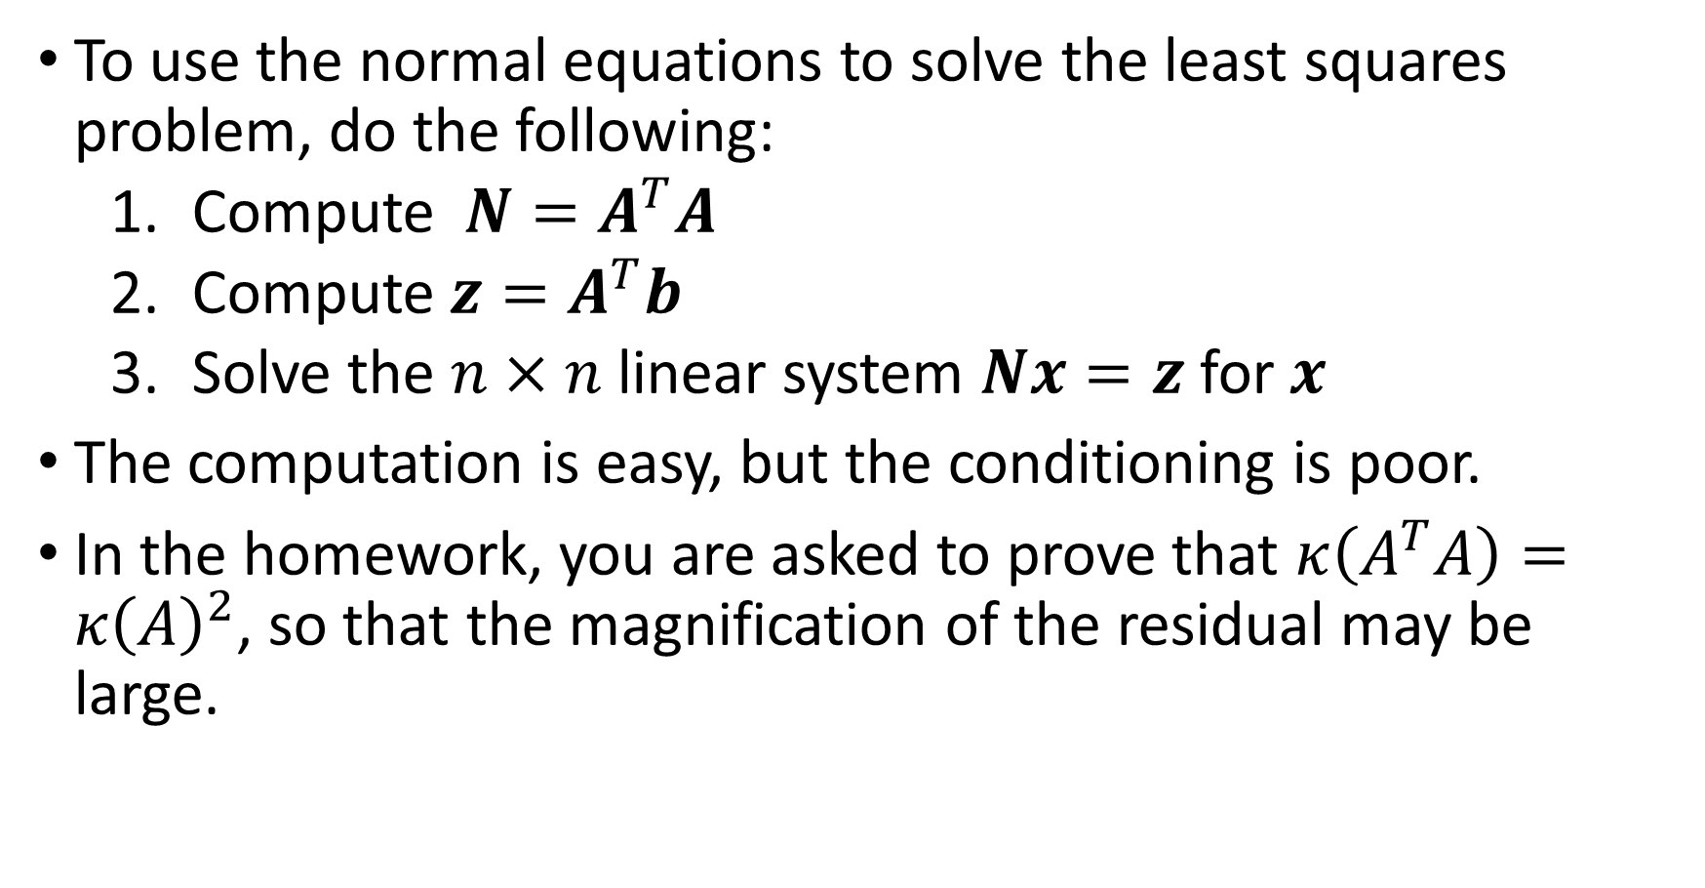
The Normal Equations
To use the normal equations to solve the least squares problem, do the following:
Compute $N=A^{T}A$
Compute ${z=A}^{T}b$
Solve the $n×n$ linear system $Nx=z$ for $x$
The computation is easy, but the conditioning is poor.
In the homework, you are asked to prove that $κ\left(A^{T}A\right)=κ{\left(A\right)}^{2}$, so that the magnification of the residual may be large.

Slide 13
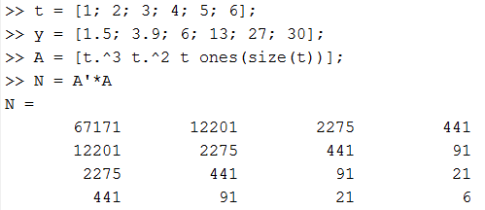
The Normal Equations
Example: do a cubic fit to some data as follows
The columns of A are powers of t (a Vandermonde matrix).

Slide 14
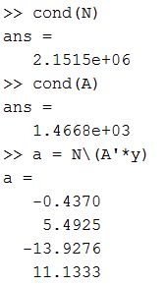

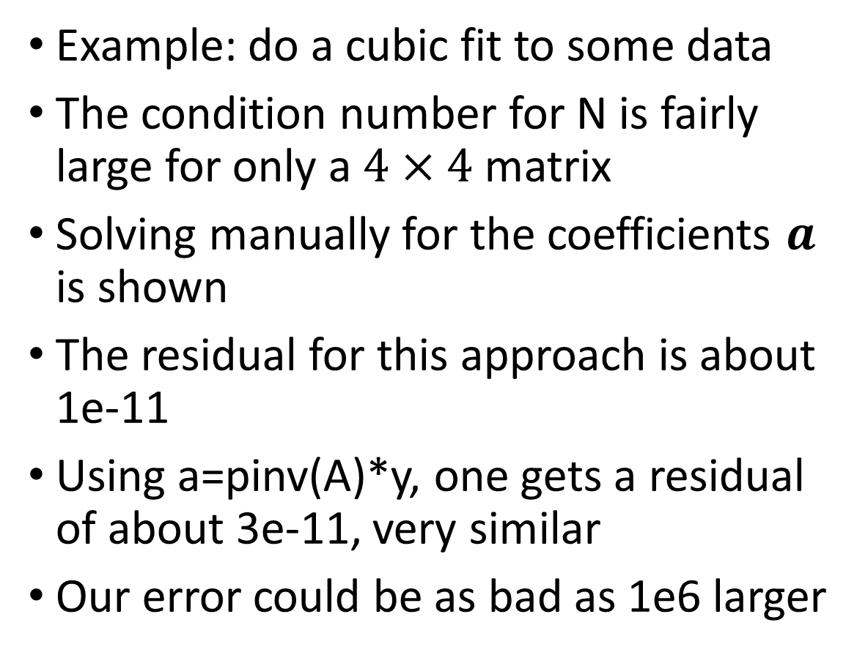
The Normal Equations
Example: do a cubic fit to some data
The condition number for N is fairly large for only a $4×4$ matrix
Solving manually for the coefficients $a$ is shown
The residual for this approach is about 1e-11
Using a=pinv(A)*y, one gets a residual of about 3e-11, very similar
Our error could be as bad as 1e6 larger

Slide 15
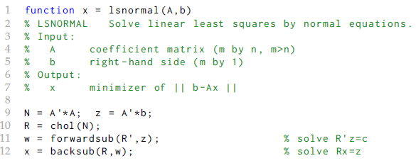

Normal Equations: better
We can do a little bit better by using Cholesky factorization because $A^{T}A$ is SPD
We do less work finding only the single upper triangular matrix R

Slide 16
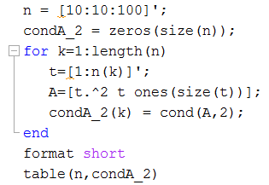
The Normal Equations
For polynomial fits, we need a Vandermonde matrix
The columns are powers of t
It’s poorly conditioned whether using Cholesky factorization or not
The underlying problem is that the columns are less different as n or the degree increases: try it.

Slide 17
Overdetermined systems: better
We need a better way to compute a least squares fit for many problems.
We can make use of a factorization that creates a matrix with orthonormal columns (an ONC matrix).
First, consider why an ONC matrix is good.
If we make orthonormal columns, the conditioning is the best we can do
In comparison, the Vandermonde matrix is poorly conditioned, but we convert it into something much better

Slide 18


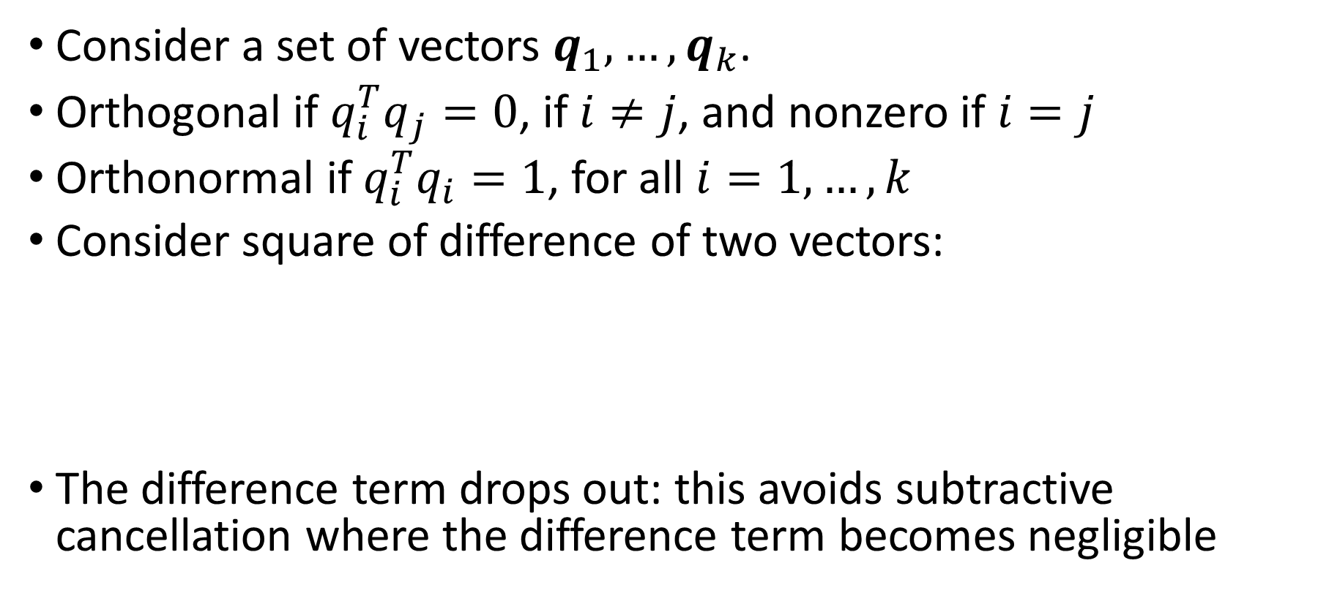
Orthonormal column (ONC) matrices
Consider a set of vectors $q_{1},…,q_{k}$.
Orthogonal if $q_{i}^{T}q_{j}=0$, if $i≠j$, and nonzero if $i=j$
Orthonormal if $q_{i}^{T}q_{i}=1$, for all $i=1,…,k$
Consider square of difference of two vectors:
The difference term drops out: this avoids subtractive cancellation where the difference term becomes negligible

Slide 19
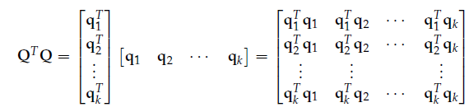

Orthonormal column (ONC) matrices
Now make a $k×k$ matrix $Q$ with ONCs: $q_{1},…,q_{k}$.
The resulting matrix is a $k×k$ identity matrix because only diagonal terms are non zero
Inverse of ONC matrix is easy: $Q^{−1}=Q^{T}$!!

Slide 20
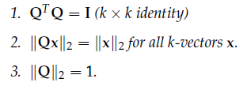

Orthonormal column (ONC) matrices
For real-valued $n×k$ matrix $Q$ with ONCs, Theorem 3.3:
For part 2: using 2 norm,

Slide 21
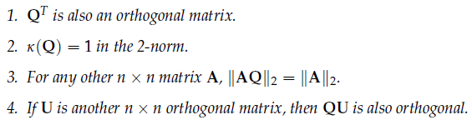

Orthonormal column (ONC) matrices
For real-valued $n×n$ matrix $Q$ with ONCs, Theorem 3.4:
Doesn’t change the norm of a matrix either, and keeps a matrix orthogonal if it started that way

Slide 22
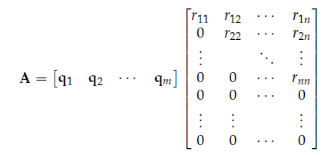
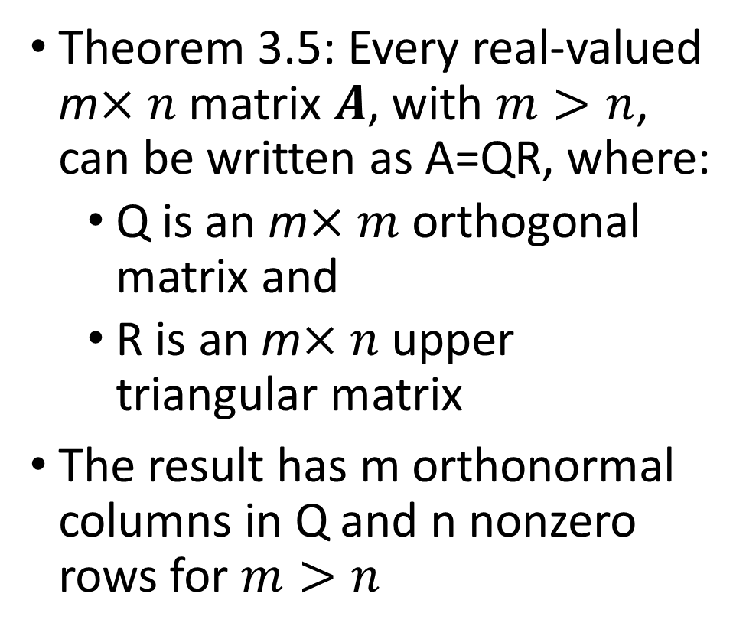
Factoring A into QR
Theorem 3.5: Every real-valued m$×n$ matrix $A$, with $m>n$, can be written as A=QR, where:
Q is an m$×m$ orthogonal matrix and
R is an m$×n$ upper triangular matrix
The result has m orthonormal columns in Q and n nonzero rows for $m>n$

Slide 23
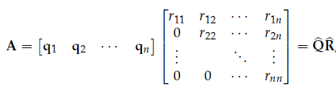
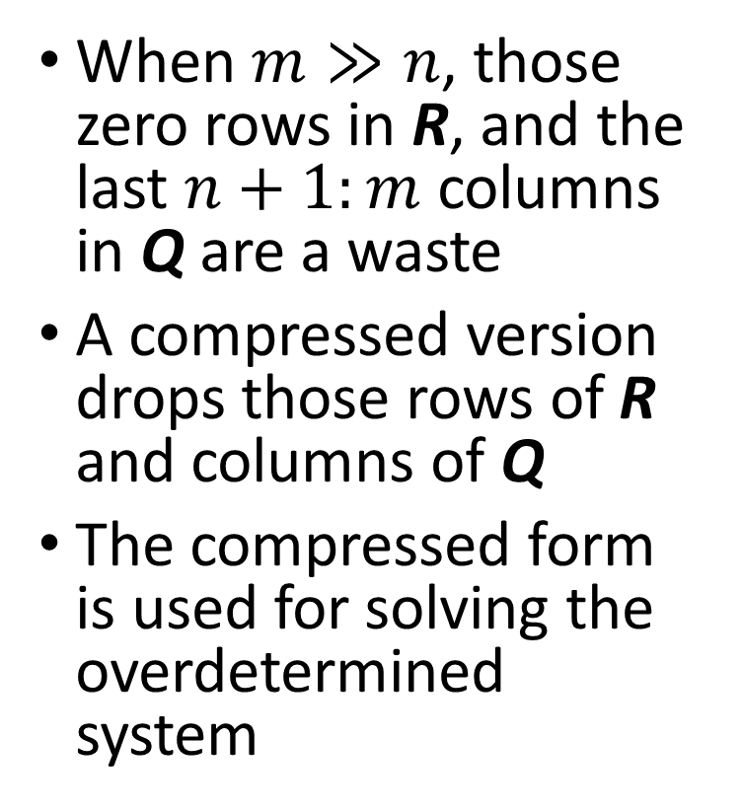
Factoring A into QR
When $m≫n$, those zero rows in R, and the last $n+1:m$ columns in Q are a waste
A compressed version drops those rows of R and columns of Q
The compressed form is used for solving the overdetermined system

Slide 24
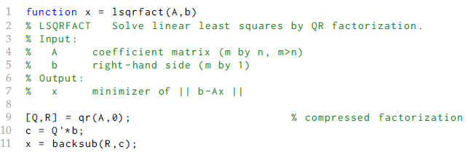
QR for overdetermined system
Apply QR factorization to A in rectangular system
Use compressed form

Slide 25
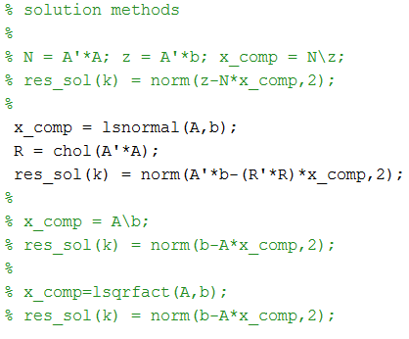
Factoring A into QR
Try what happens with different methods
Start with vdmonde_cond.m and vdmonde_solns.m

Slide 26
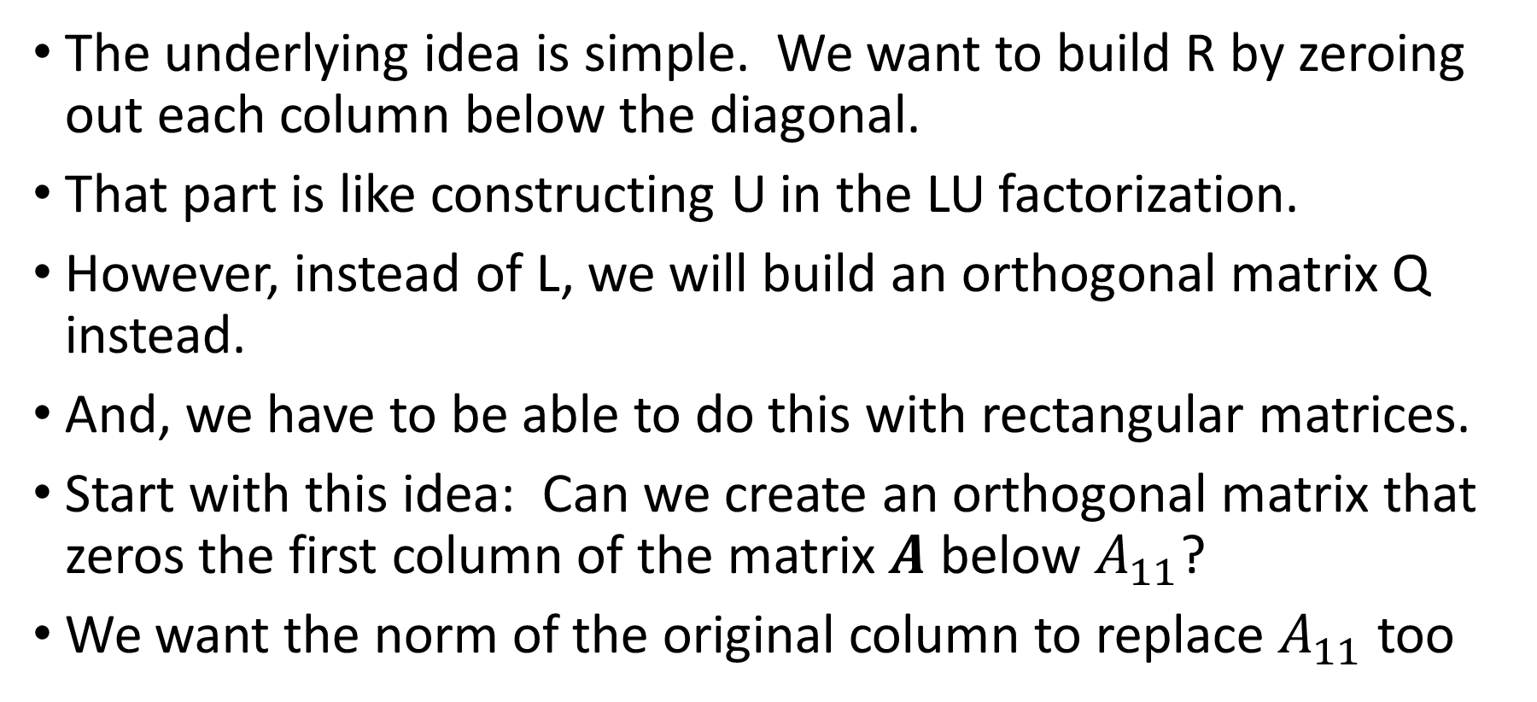
How to compute the QR factorization?
The underlying idea is simple. We want to build R by zeroing out each column below the diagonal.
That part is like constructing U in the LU factorization.
However, instead of L, we will build an orthogonal matrix Q instead.
And, we have to be able to do this with rectangular matrices.
Start with this idea: Can we create an orthogonal matrix that zeros the first column of the matrix $A$ below $A_{11}$?
We want the norm of the original column to replace $A_{11}$ too

Slide 27
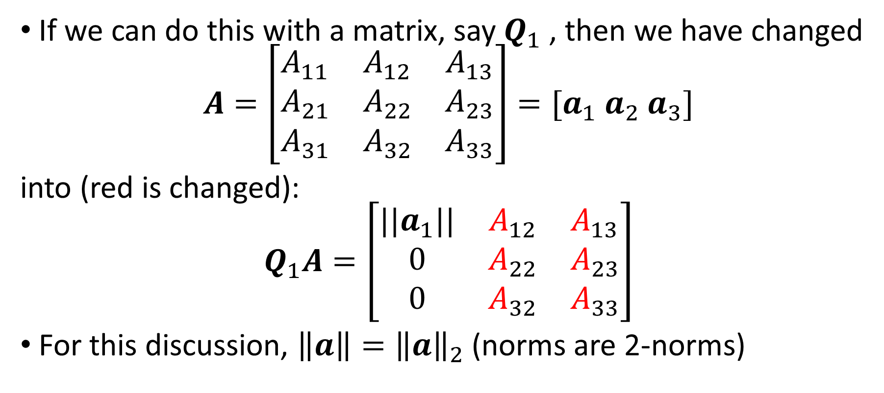
Computing the QR factorization
If we can do this with a matrix, say $Q_{1}$ , then we have changed
$$A=\left[\begin{matrix}A_{11} & A_{12} & A_{13} \\ A_{21} & A_{22} & A_{23} \\ A_{31} & A_{32} & A_{33}\end{matrix}\right]=[a_{1} a_{2} a_{3}]$$
into (red is changed):
$$Q_{1}A=\left[\begin{matrix}{||a}_{1}|| & A_{12} & A_{13} \\ 0 & A_{22} & A_{23} \\ 0 & A_{32} & A_{33}\end{matrix}\right]$$
For this discussion, $\left\|a\right\|={\left\|a\right\|}_{2}$ (norms are 2-norms)

Slide 28
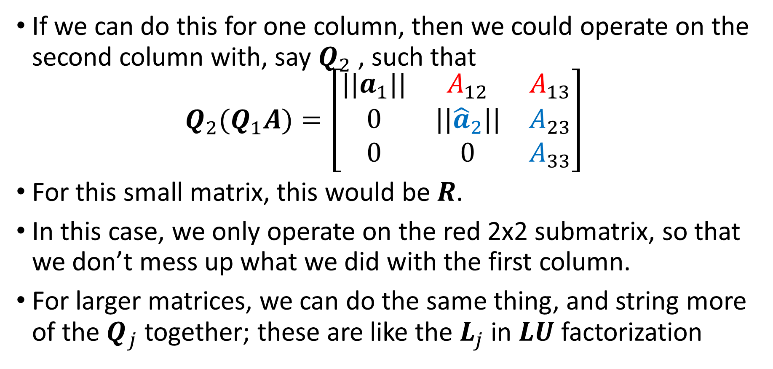
Computing the QR factorization
If we can do this for one column, then we could operate on the second column with, say $Q_{2}$ , such that
$$Q_{2}(Q_{1}A)=\left[\begin{matrix}{||a}_{1}|| & A_{12} & A_{13} \\ 0 & ||{\hat{a}}_{2}|| & A_{23} \\ 0 & 0 & A_{33}\end{matrix}\right]$$
For this small matrix, this would be $R$.
In this case, we only operate on the red 2x2 submatrix, so that we don’t mess up what we did with the first column.
For larger matrices, we can do the same thing, and string more of the $Q_{j}$ together; these are like the $L_{j}$ in $LU$ factorization

Slide 29
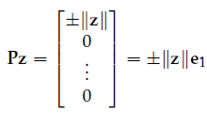
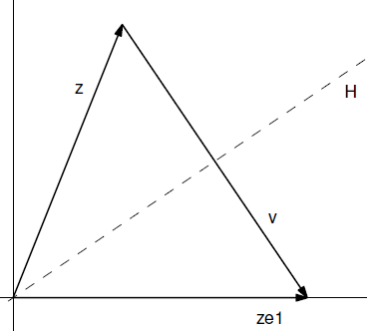
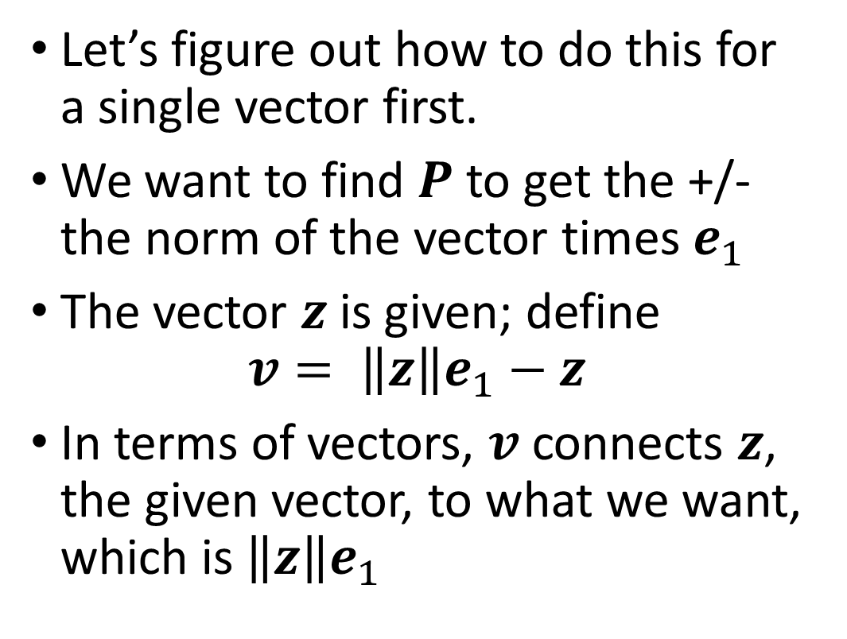
Computing the QR factorization
Let’s figure out how to do this for a single vector first.
We want to find $P$ to get the +/- the norm of the vector times $e_{1}$
The vector $z$ is given; define
$$v= \left\|z\right\|e_{1}−z$$
In terms of vectors, $v$ connects $z$, the given vector, to what we want, which is $\left\|z\right\|e_{1}$

Slide 30
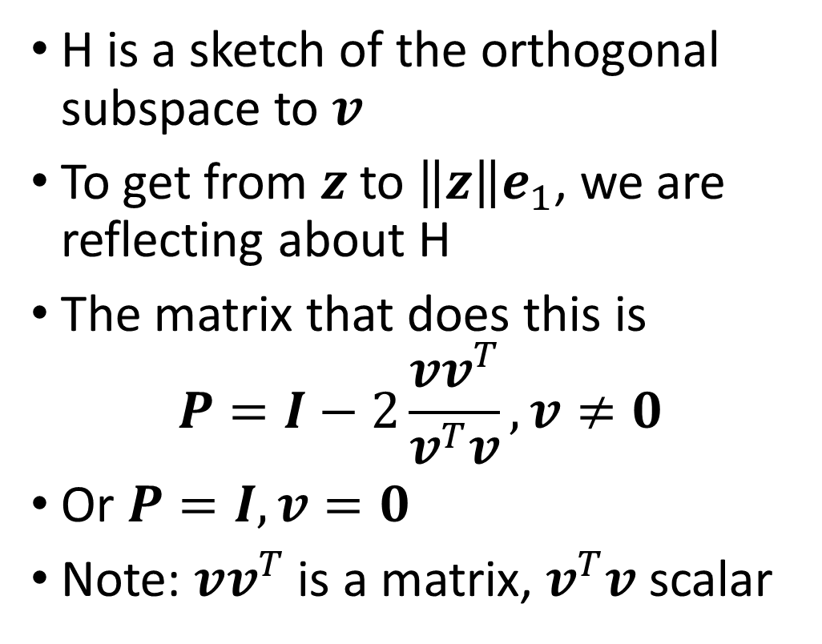
Computing the QR factorization
H is a sketch of the orthogonal subspace to $v$
To get from $z$ to $\left\|z\right\|e_{1}$, we are reflecting about H
The matrix that does this is
$$P=I−2\frac{vv^{T}}{v^{T}v}, v≠0$$
Or $P=I, v=0$
Note: $vv^{T}$ is a matrix, $v^{T}v$ scalar

Slide 31
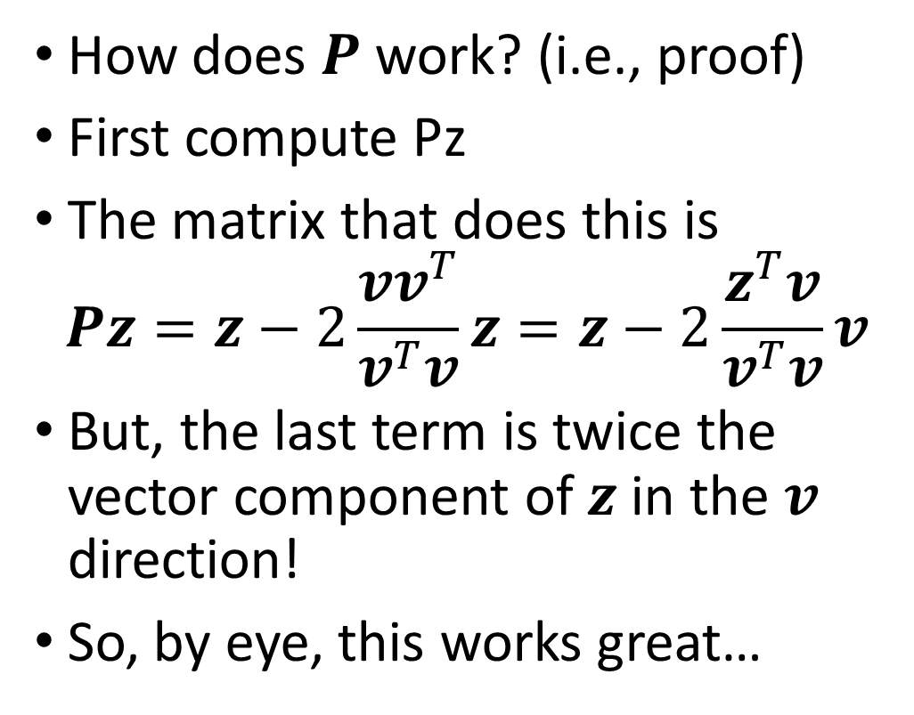
Computing the QR factorization
How does $P$ work? (i.e., proof)
First compute Pz
The matrix that does this is
$$Pz=z−2\frac{vv^{T}}{v^{T}v}z=z−2\frac{z^{T}v}{v^{T}v}v$$
But, the last term is twice the vector component of $z$ in the $v$ direction!
So, by eye, this works great…

Slide 32
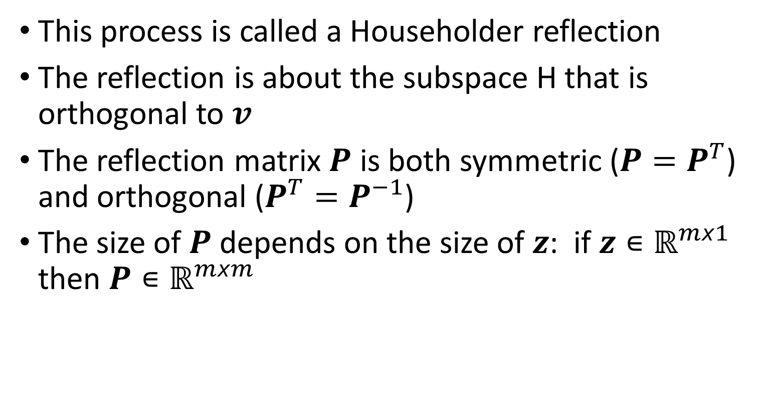
Computing the QR factorization
This process is called a Householder reflection
The reflection is about the subspace H that is orthogonal to $v$
The reflection matrix $P$ is both symmetric ($P=P^{T}$) and orthogonal ($P^{T}=P^{−1}$)
The size of $P$ depends on the size of $z$: if $z∊ℝ^{mx1}$ then $P∊ℝ^{mxm}$

Slide 33


Computing the QR factorization
Proving it now, we need
Then we find
Just what we needed!

Slide 34
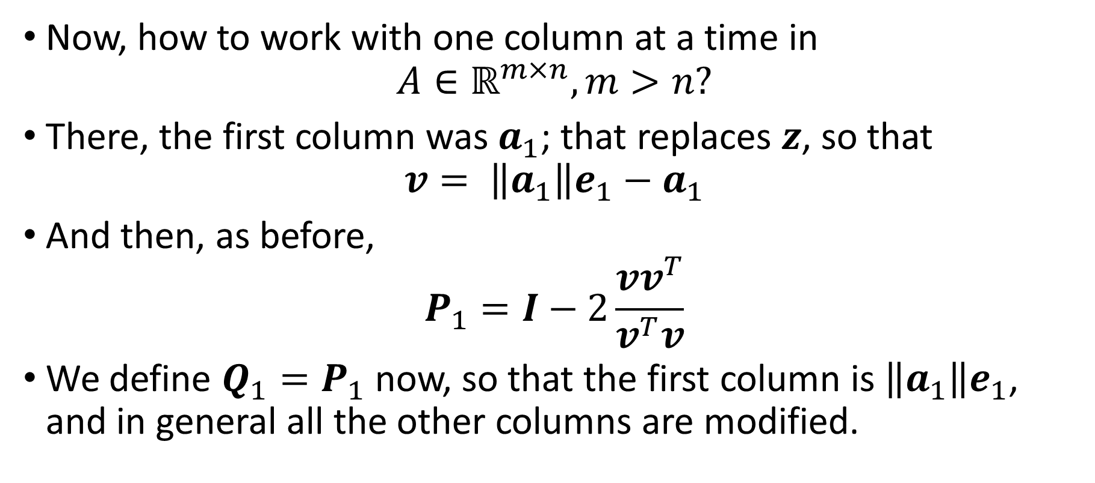
Computing the QR factorization
Now, how to work with one column at a time in
$$A∈ℝ^{m×n}, m>n?$$
There, the first column was $a_{1}$; that replaces $z$, so that
$$v= \left\|a_{1}\right\|e_{1}−a_{1}$$
And then, as before,
$$P_{1}=I−2\frac{vv^{T}}{v^{T}v}$$
We define $Q_{1}=P_{1}$ now, so that the first column is $\left\|a_{1}\right\|e_{1}$, and in general all the other columns are modified.

Slide 35
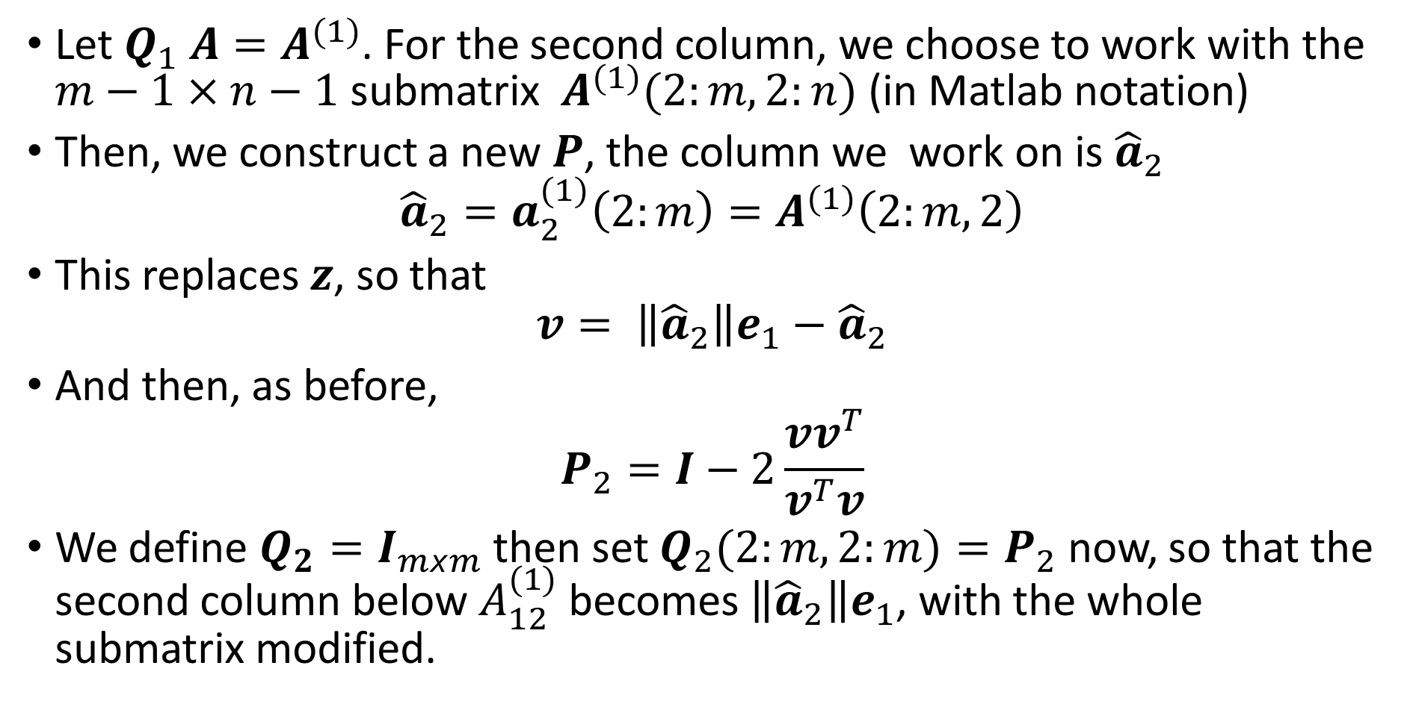
Computing the QR factorization
Let $Q_{1} A=A^{(1)}$. For the second column, we choose to work with the $m−1×n−1$ submatrix $A^{(1)}(2:m,2:n)$ (in Matlab notation)
Then, we construct a new $P$, the column we work on is ${\hat{a}}_{2}$
$${\hat{a}}_{2}=a_{2}^{(1)}\left(2:m\right)=A^{(1)}\left(2:m,2\right)$$
This replaces $z$, so that
$$v= \left\|{\hat{a}}_{2}\right\|e_{1}−{\hat{a}}_{2}$$
And then, as before,
$$P_{2}=I−2\frac{vv^{T}}{v^{T}v}$$
We define $Q_{2}=I_{mxm}$ then set $Q_{2}(2:m,2:m)=P_{2}$ now, so that the second column below $A_{12}^{(1)}$ becomes $\left\|{\hat{a}}_{2}\right\|e_{1}$, with the whole submatrix modified.

Slide 36
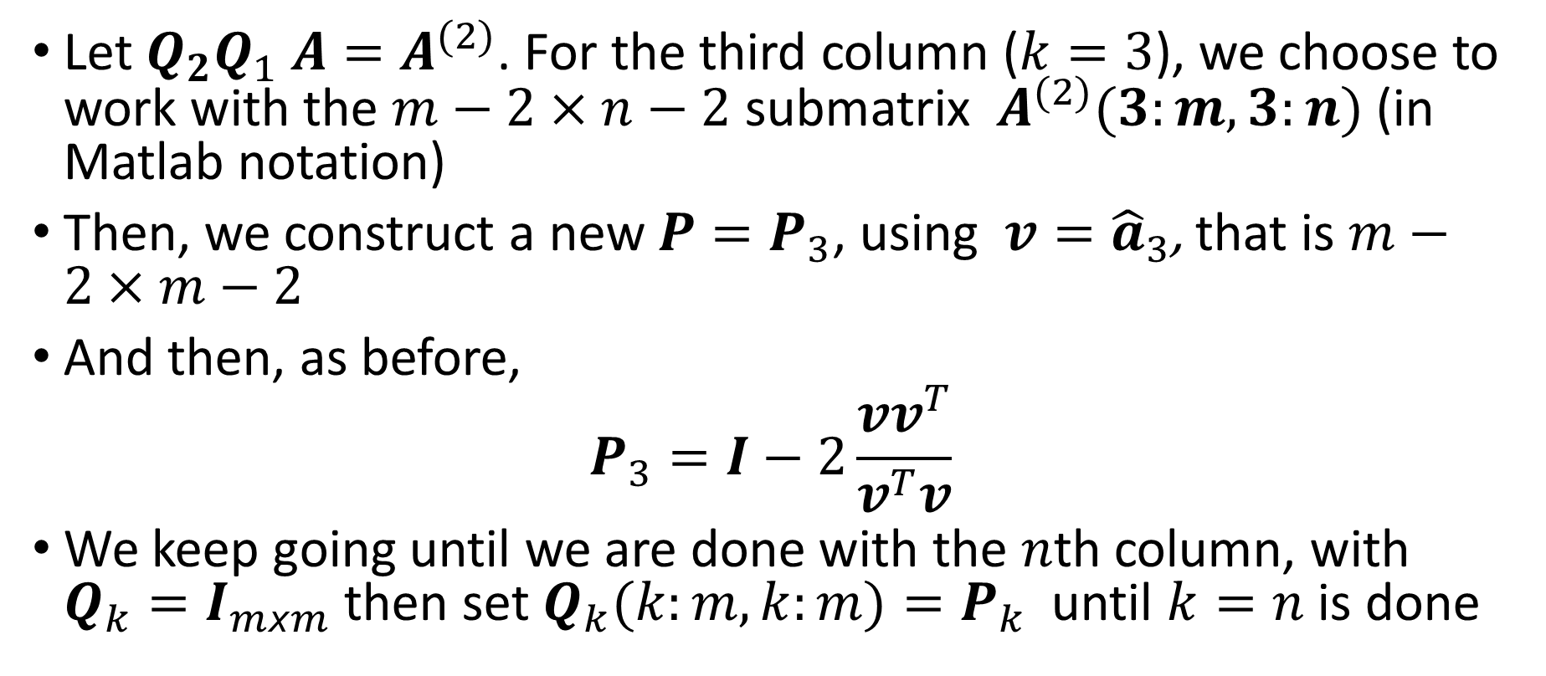
Computing the QR factorization
Let ${Q_{2}Q}_{1} A=A^{(2)}$. For the third column ($k=3$), we choose to work with the $m−2×n−2$ submatrix $A^{(2)}(3:m,3:n)$ (in Matlab notation)
Then, we construct a new $P=P_{3}$, using $v={\hat{a}}_{3}$, that is $m−2×m−2$
And then, as before,
$$P_{3}=I−2\frac{vv^{T}}{v^{T}v}$$
We keep going until we are done with the $n$th column, with $Q_{k}=I_{mxm}$ then set $Q_{k}(k:m,k:m)=P_{k}$ until $k=n$ is done

Slide 37
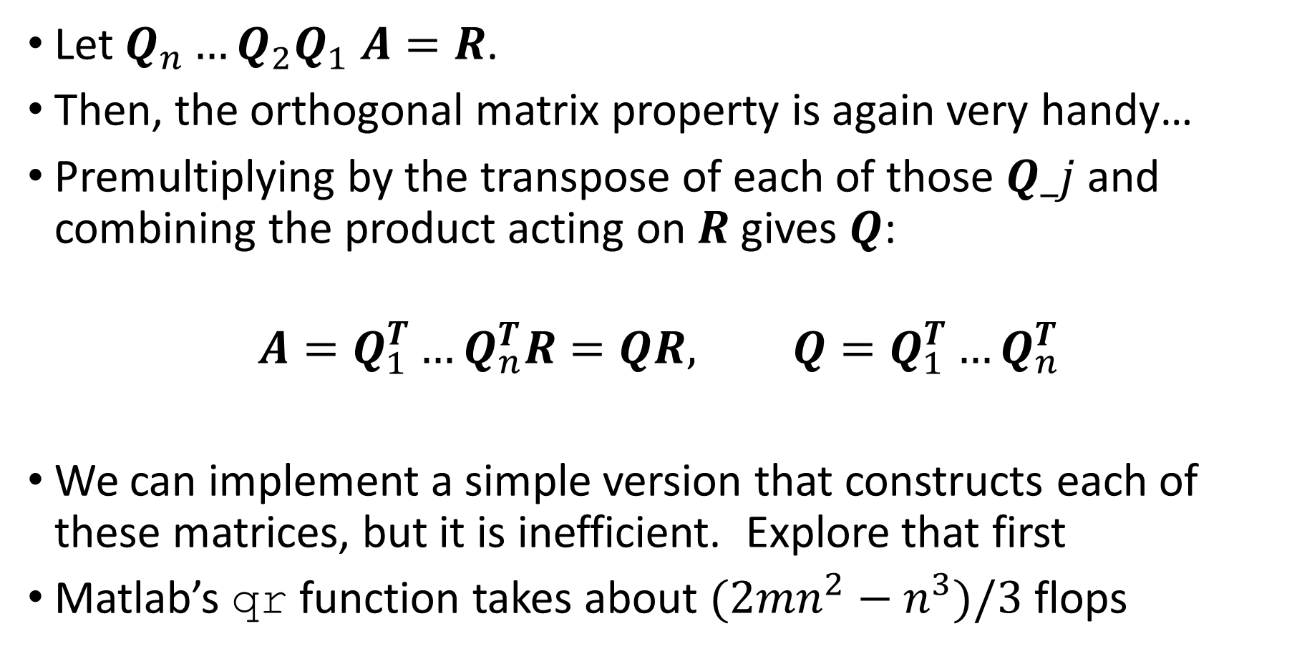
Computing the QR factorization
Let ${{Q_{n}…Q}_{2}Q}_{1} A=R$.
Then, the orthogonal matrix property is again very handy…
Premultiplying by the transpose of each of those $Q_j$ and combining the product acting on $R$ gives $Q$:
$$A=Q_{1}^{T}…Q_{n}^{T}R=QR, Q=Q_{1}^{T}…Q_{n}^{T}$$
We can implement a simple version that constructs each of these matrices, but it is inefficient. Explore that first
Matlab’s qr function takes about $(2mn^{2}−n^{3})/3$flops

Slide 38
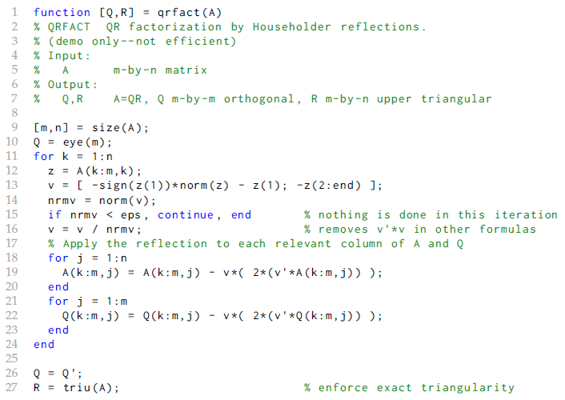
Computing the QR factorization
Function from text: qrfact.m

Slide 39
Computing the QR factorization
Download qrfact.m from Sakai (in files from book)
Edit qrfact.m into a script or the function qrfactshow.m as in the handout you are given.
Reproduce that example from qrfactshow.m
If time permits, I will have additional data.

